Slide 1
TRBIO 431 · DEVELOPING A GRANT PROPOSAL
AI for grant writing
What it is, what it does better than you, what it does worse, and an hour of practice on your own writing
Benjamin Good · Scripps Research · 6 November 2026
Notes:
80 minutes. Half setting the stage on what AI is, what it is good at, what it is not good at, and how to think about your relationship to it – especially in the context of grantwriting. Second half we will dive into how to use it effectively.

Slide 2
WHERE THIS STARTS
Part 1: How will you relate?
will be empowered by
You
will learn from
“AI”
will be governed by
will be replaced by
will be made dumber by
… ?
Notes:
How you choose to use, or be used by, AI will play a defining role in the rest of your career as a scientist and as a technical human.
Worth a moment before the content: nobody in this room gets to opt out of the question. The choice is which of these verbs describes you in five years, and that is mostly decided by habits you form now rather than by the technology.

Slide 3
WHAT IT IS
A prediction engine, not a truth engine
It learns what tends to fit together, then builds a response one small piece at a time.
1
LEARN PATTERNS
2
PREDICT WHAT FITS
3
BUILD A RESPONSE
From huge amounts of text, images, and other examples
Given your prompt, it estimates what should come next
Repeats that prediction, one small piece at a time
words
pictures
“The capital of France is …”
The
answer
is
Paris.
patterns
examples
Paris
...and keeps going
Plausible is not necessarily true.
Notes:
This is the mechanism, and everything later follows from it.
It is trained to produce text that fits. Truth correlates with fit rather than being identical to it, which is why the two come apart exactly where a claim is specific, recent, or about you.
AI is an excellent partner for exploring ideas. That does not automatically make it a good judge of which ideas are original, feasible or important, and the second line of the band is the one to dwell on: recombining what exists is what it does by construction.

Slide 4
“AI” is evolving, from chat to agents.
From chatting about a grant to working on the grant
Tool access + a plan–act–check loop turn a single response into an iterative workflow.
CHAT ALONE
AGENTIC AI
Ask: “Draft an abstract.”
Goal: “Build a funder-ready biosketch.”
PROMPT → DRAFT
1 PLAN
2 USE TOOLS
3 CHECK
4 REVISE
Parse the call,
set requirements
Search papers,
read files
Verify citations,
spot gaps
Improve draft,
repeat
Produces fluent text from patterns it learned — but may invent evidence or citations.
↺ Use feedback and new evidence to keep improving the work
MORE POWERFUL
STILL NEEDS OVERSIGHT
Research • source checking • code • budget math • real files
Bad assumptions can cascade
This is already inside familiar interfaces. Claude Cowork and ChatGPT Work bring agentic workflows into what used to be a chat box, which is what we are using today. (Cowork is merging into Claude as one product)
Notes:
This is why today is hands-on in a folder rather than in a chat window.
Chat alone produces one response from a prompt. Everything it says comes from patterns, including the citations, which is exactly where invention happens.
The agentic loop is different in kind, not degree: it can open your actual files, run a script, check its own output against a source, and go round again. The biosketch exercise later is precisely this loop, and you will watch it happen.
The oversight line matters because the loop also compounds mistakes. A wrong assumption in step one gets built on in steps two through four, and arrives looking thoroughly worked out.

Slide 5
WHAT IT IS
The nature of Claude, and of all generative AI
What makes it useful
· Uniform effort, no fatigue
· Holds all your materials at once
· Takes any viewpoint on command
· More tools, more power
What makes it dangerous
· Optimizes for plausible, not true
· Fluency says nothing about correctness
· Knows the distribution, not your case
· More tools, more power…
These are not equally durable.
Tool calls and loops improving fast.
Pull toward the distribution (plausible is not right or original) is in the nature of an LLM.
Notes:
The right column is one property wearing five coats, and it is the mechanism from two slides ago seen from the outside.
The second line is the one that changes how you have to work. In human writing, hedging and clumsiness leak uncertainty and we read that unconsciously. Here the channel is cut: the confident sentence and the fabricated one are stylistically identical.
The third line is why a model cannot hand you a distinctive proposal. Conventional polish and distinctive positioning are the same dial, set to the middle by construction.
On the left, uniform effort is a real superiority over any human reader: the two-hundredth citation gets what the first got. So is holding everything at once, because you write a proposal linearly over weeks and lose track of your own numbers.
The footnote matters if anyone is carrying a 2023 impression. Some of this is improving fast. The structural ones will not.

Slide 6
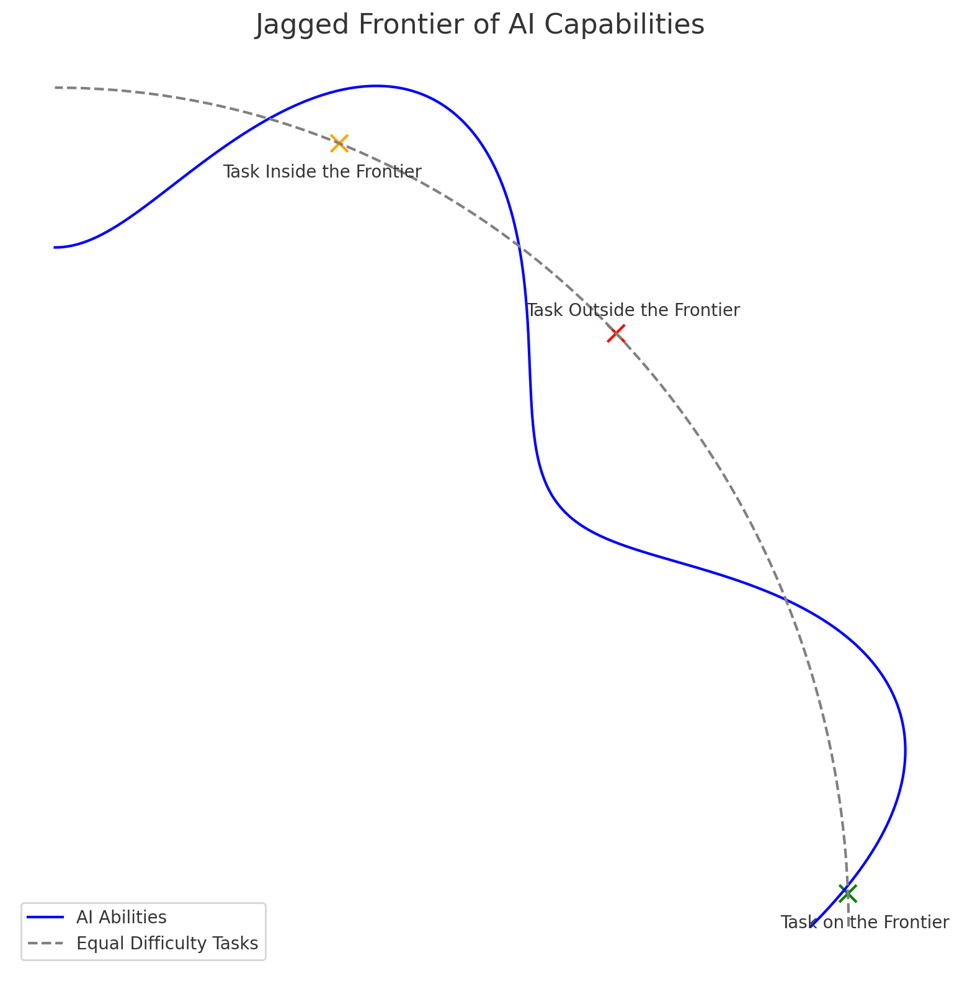
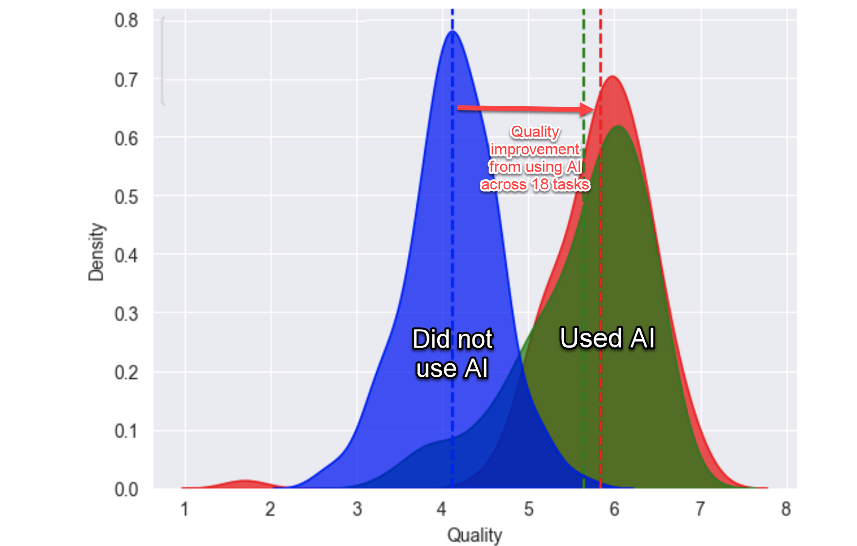
AND IT IS A MOVING TARGET
The jagged frontier
AI is better than you at some tasks and worse at others, and the line between them (a) changes day by day and (b) does not follow your sense of what is hard.
Just outside it
Right without AI
84.5%
Right with AI
70.6%
758 consultants, 18 tasks,
inside the frontier
Dell'Acqua F, Mollick E, et al., Navigating the Jagged Technological Frontier, 2023. Frontier chart after Ethan Mollick, oneusefulthing.org/p/centaurs-and-cyborgs-on-the-jagged
Notes:
Two things are true at once. Capability varies enormously across tasks that look equally hard to us, and it keeps moving.
The same consultants did two tasks. On the one inside the frontier, the AI group completed more, faster, at higher quality, which is the density plot. On a task just outside it, needing careful reading of data and interviews, the control group was right 84.5% of the time and the AI group 70.6%, and the AI group's wrong answers were rated more persuasive.
The consultants could not feel which side of the line they were on. That is the hard part, and it is why I am not going to hand you a rule. The goal today is to see roughly where the line sits for grant writing right now, while respecting that it will move.
Distribution of output quality across all the tasks. The blue group did not use AI, the green and red groups used AI, the red group got some additional training on how to use AI.

Slide 7

WHERE THIS GOES
Fight full self-automation…
Self-Automators
Self-Automator
Complete delegation
Learn nothing about the subject or AI
Produce lower quality work that looks fine on the surface
It’s an easy slide, even for strong people with reasons not to
You
AI
“Write my specific aims section.”
“Design my approach”
Centaurs, cyborgs and a third mode, self-automators, who handed the work over and gained no new skills. Randazzo S, Lifshitz-Assaf H, et al. Field study of 244 consultants. SSRN 4921696, working paper.
Notes:
The warning first, from the same study as the next slide. Of 244 Boston Consulting Group consultants given one business case and GPT-4, 27% worked this way: they handed the AI the task and the data and took back what it produced, with little back and forth (PDF p. 12).
Learn nothing: the authors found what they call no skilling in this group, no gain in knowledge of the problem and none in skill with AI (p. 36). Their own advice is to avoid this mode if you want to develop skills (p. 44). For a trainee that is the whole point. One participant put it plainly: “at this level most of the learning should come from me… I should be actively learning and should not be so reliant on it so soon” (p. 20).
Lower quality that looks fine: self-automators were less accurate than centaurs and less persuasive than both centaurs and cyborgs (p. 36), and the authors describe their work as “fast and polished but lacked depth” (p. 12). Of the 63, 44% accepted the output unchanged and the rest made only superficial edits, so they handed over judging the work as well as doing it (p. 29).
An easy slide: these were skilled, conscientious junior consultants who had been told good performance would be noted in their annual review (pp. 39, 43). The reasons were ordinary: “It gave me something that seemed okay. I did a quick sanity check”, and “I don't want to write 500 words” (p. 21).
To be fair to the authors, they say handing work over is not inherently a problem for routine, time-pressed tasks well inside what the model does well (p. 39). Caveats: a working paper, one session, GPT-4 from April 2023 (p. 42). Page numbers are PDF pages.
Source: Randazzo S, Lifshitz H, Kellogg KC, Dell'Acqua F, Mollick E, Candelon F, Lakhani KR. Cyborgs, Centaurs and Self-Automators: the three modes of human-GenAI knowledge work. Harvard Business School Working Paper 26-036, 2025. https://doi.org/10.2139/ssrn.4921696

Slide 8


WHERE THIS GOES
Centaur or Cyborg ?
Centaur
Cyborg
A strict, intentional division of labor
Work blended as you go
You
AI
“Check that I met all the guidelines.” “Review my grant like a committee…”
Back and forth with it as you write your Aims, research agents on call, creative control kept by you.
How you work is up to you. Think about it on purpose, or you will end up following another algorithm that wasn't built to make you happy or successful.
Centaurs, cyborgs and a third mode, self-automators, who handed the work over and gained no new skills. Randazzo S, Lifshitz-Assaf H, et al. Field study of 244 consultants. SSRN 4921696, working paper.
Notes:
Back to the question we started with: how will you relate to it?
Today is the centaur path. A strict, intentional division of labor, decided before you start: each job is yours or the model's. It is the easier path to teach, and the easier one to defend to a study section and to yourself.
The cyborg path is open too. You go back and forth with it as you write your Aims, research agents find and check sources while you draft, and you keep creative control. It takes more judgment in the moment, because the line between your work and its work gets redrawn every few minutes.
The names come from a study of 244 Boston Consulting Group consultants given the same business case, the same tool (GPT-4) and the same instructions. They sorted themselves into three modes: 60% cyborgs, 14% centaurs and 27% self-automators. Centaurs were the most accurate, and centaurs and cyborgs both wrote more persuasive memos than self-automators. Centaurs deepened their knowledge of the problem; cyborgs built skill at working with AI.
Self-automators did the whole task in one or two exchanges: paste all the data into one prompt, accept what comes back. 44% of them changed nothing at all. The authors ask two questions, who decides what gets done and who decides how. Self-automators gave up both, and nobody in the study kept the what while handing over the how.
The plus side is real. It was the fastest mode, the output looked polished, and the authors say handing over is reasonable for routine work, tight deadlines and problems well inside what the model does well, when building skill is not the point. The minus side: the least accurate and least persuasive work, and what the authors call no skilling, gaining neither knowledge of the problem nor skill with AI. It is also invisible in the output. A self-automator who took the first answer looks the same as a cyborg who iterated and then accepted.
For you: self-automating is defensible for the mechanical jobs, like page and character limits. For a trainee it is the worst trade there is, because the point of an F31 is your training, and it runs into NIH's rule that applications substantially developed by AI will not be considered (NOT-OD-25-132, slide 17).
Caveats: it is a working paper, not peer reviewed. It studied consultants on one business case with a 2023-era model. People chose their own mode, so the differences in results are associations, not effects of the mode. Use it as a frame rather than a result.
Source: Randazzo S, Lifshitz-Assaf H, Kellogg K, Dell'Acqua F, Mollick ER, Candelon F, Lakhani KR. Cyborgs, centaurs and self-automators. Harvard Business School Working Paper 26-036; SSRN 4921696. https://doi.org/10.2139/ssrn.4921696. The mode shares, the 44% figure and the outcome comparisons were checked against the full working paper on 4 November 2026 (PDF pages 12, 29 and 36). Candelon F, Kellogg K, Lifshitz H, Randazzo S, Fortune, 30 January 2026, https://fortune.com/2026/01/30/ai-business-humans-in-the-loop-cyborg-centaur-or-self-automator/. HBS AI Institute, 29 December 2025, https://aiinstitute.hbs.edu/the-three-ways-professionals-work-with-ai-which-one-are-you/
The self-automators are the warning. How you work is up to you, so think about it on purpose. If you do not, you will end up following another algorithm, and that one was not built to make you happy or successful.

Slide 9
SO THE QUESTION IS NOT WHETHER TO USE IT OR NOT, IT IS WHEN AND HOW
Powerful, not all-powerful
A grant is not one job. It is a dozen jobs and AI is excellent at some of them and actively dangerous at others.
1
What is it better at than you?
2
What is it worse at than you?
3
What else are you gaining from the process?

Slide 10
THE WORK ITSELF
Twelve jobs in writing a grant
1
Find and document the grant's guidelines
2
Find and read the literature
3
Define the gap and the hypothesis
4
Write the Specific Aims
5
Design the study and the statistics
6
Draft Significance and Approach
7
Check sections against a checklist
8
Review it the way a panel will
9
Make numbers and claims agree
10
Meet page and character limits
11
Build the biosketch and budget
12
Get feedback from mentors
Constructed for this seminar, informed by the course's sessions and the section checklists in the starter folder.
Notes:
Nobody writes a grant. People do these twelve things and a grant comes out.
Before I split the list, try it yourself. Take number 5, the statistics. If a model handed you a power calculation, how would you know it was right? You would have to do the power calculation. Now take number 10, the character limits. How would you know? You would count. That difference is the whole split.
Note that the list starts once you have a target. Choosing which mechanism to apply for is a conversation with your mentor, and a model with no live data source will invent plausible funding opportunity numbers if you ask it.

Slide 11
THE WORK ITSELF
The same twelve, classified
Do it yourself
Delegate to AI
1
Find and document the grant's guidelines
2
Find and read the literature
3
Define the gap and the hypothesis
4
Write the Specific Aims
5
Design the study and the statistics
6
Draft Significance and Approach
7
Check sections against a checklist
8
Read it the way a panel will
9
Make numbers and claims agree
10
Meet page and character limits
11
Build the biosketch and budget
12
Get feedback from mentors
Same twelve, same places. Six and six, and the next two slides are about why the line falls here.
Notes:
Same twelve jobs, now sorted. Give them a moment to read it before you say anything, and ask whether anyone would move one.
The two most arguable are 6 and 8. Drafting Significance is on the left because the words have to be yours, but having it critiqued is on the right, and that distinction is the hinge of the whole session. Reading it the way a panel will is on the right only because you can check the result against your own page.
If someone argues for moving one, that is the right conversation to have. The line is not a law; it is where the line sits today for most people in this room.

Slide 12
WHY HAND OVER 1, 7, 8, 9, 10, 11
Because this is where it is strong
The source is in front of you to check against
1 Guidelines
7 Checklist
11 Biosketch, budget
Tedium at volume costs it nothing
1 Guidelines
7 Checklist
9 Numbers agree
A script can settle anything exact
10 Limits
11 Biosketch, budget
A wrong answer can be caught
9 Numbers agree
It can take on different perspectives
8 Panel read
Notes:
Hold the model's reading of the announcement against the announcement. See whether the mock panel's retelling of your aim matches what you meant, and if it does not, that is a finding about your page rather than about the model.
Nine is the one people underrate. Numbers drift between sections because prose gets reread and numbers get carried forward. That is miserable work for a tired human at 2am and nothing at all for a machine that holds the whole document at once.
The last line is the mock panel in one phrase. You cannot un-know your own expertise; it can read your page as a generalist on request, three times, without ego.
Eleven is the one place the model writes prose you will actually submit, and that is defensible only because the form is rigid and every claim traces to your own CV.
Each card carries the jobs it explains. Ten appears once, because a script counts. The first card carries the most: guidelines, checklists and the biosketch are safe to hand over because the source is in front of you to check against.

Slide 13
WHY KEEP 2, 3, 4, 5, 6, 12
Because you
Are more creative!
3 Gap, hypothesis
4 Aims
6 Significance
Need to learn
2 Literature
5 Study design
12 Mentors
Know things written down nowhere
3 Gap, hypothesis
5 Study design
Know when you don't really know
2 Literature
5 Study design
Proposals written with heavy AI involvement were measurably less distinctive, sitting closer to what had just been funded. Qian Y, Wang D, et al., PNAS, 11 August 2026. Correlation, not cause.
Notes:
Each of the six fails for its own reason, and it is worth naming them as you go.
Two, the literature. You can check in seconds that a paper exists. You cannot check that it supports your sentence without reading it. An invented reference is the easy case and a shrinking one; a real, correctly formatted, topically plausible paper cited for something it never established is the expensive one.
Three and four: your judgment is the product, not the input. A hypothesis is a bet with your name on it, deliberately sharp enough to be wrong. Something with nothing to lose hedges toward whatever is defensible, which is the opposite move.
Five: checking the power calculation means doing the power calculation.
Six: fluent and generic loses to rough and yours, which is what the footnote is about. Northwestern combined confidential submissions from two large universities with every public NSF and NIH award from 2021 to 2025. More AI involvement went with less distinctive proposals. It is observational and involvement was inferred from word statistics, so do not oversell it, but it is what you would predict from a system trained on everyone else's proposals.
And twelve is the reminder that none of this replaces your mentors. The point of the next hour is to arrive at their door with something better than a first draft.
Twelve appears once, and for a trainee it is the reason that matters most. Two and five carry the fourth card: you can tell when you do not really understand a paper or a power calculation, and a model, fluent either way, cannot.

Slide 14
A SHORTCUT WHEN YOU ARE UNSURE
If, then
If the nature of the task is mechanical (fact check, formatting, number matching, running code, running through a checklist, etc.)
Delegate it. Save your time, make your product more consistent and more thoroughly checked.
If the nature of the task is creative, personal or something that helps you learn (hypothesis generation, writing specific aims, reading to understand the problem, etc.)
Keep it. That is your job – you are better than AI and the job will help you grow.
Notes:
One slide, four lines, and the second is the one that handles scale. You can check three citations over coffee. Nobody checks two hundred by hand, so you sample twelve, and if two fail you have not found two problems, you have found out the set is unreliable.
The last row is the line of principle.
One more worth saying out loud: when an error would be silent and you sign for it, check it every time regardless of what this slide says. A grant is submitted once, under a certification that carries liability, and nothing tells you later that you got it wrong.

Slide 15
HANDS ON
Part 2: How to use AI
to improve your grant
We will learn:
How to set up a Claude project
How to use the CLAUDE.md file
How to use Skills in Claude
Specific skills for working with different sections of grants
Notes:
Part 2 is the hands-on hour, in the order on the slide. I show the first three live, on something that has nothing to do with grants: a prompt, then a project with its CLAUDE.md, then a skill. Then you open the grant project, look inside it, and run its skills on your own writing.

Slide 16
“AI”
WHAT WE ARE USING TODAY
Claude, on your Scripps account
Download the desktop app: claude.com/download
Log in with your Scripps email, using the SSO option.
Do not use personal accounts on Claude, ChatGPT or any other AI service. Our agreement with Anthropic protects your privacy and your IP; a personal account does not.
Caveats
In certain circumstances, such as a legal challenge, Anthropic can see your messages.
It does not satisfy every law on personal information. For PII or HIPAA coverage, ask IT first.
Scripps Research Policy treats a funding proposal as confidential material, so it goes only into approved tools.
Notes:
Everyone should be signed in before we go further. Use the SSO option with your Scripps address; that is the account covered by the agreement.
We need the desktop app rather than the website, because the exercise works on a folder of files on your own machine.
Be straight about the caveats rather than overselling the protection. The agreement is good and it is not absolute: legal process can reach your messages, and it does not by itself cover regulated categories like PHI. If your work touches those, talk to IT before you put anything in.
If anyone is stuck here, pair them with a neighbour now rather than losing them for the next hour.

Slide 17
THE FLOOR
Four lines you cannot cross
Your proposal in a non-approved AI tool
Scripps Research Policy 708
A classmate's draft in any AI tool
TRBIO 431/432 agreement
An application substantially developed by AI
NIH NOT-OD-25-132
AI-invented references presented as real
NIH and HHS ORI, May 2026
NIH: applications substantially developed by AI “are not considered the original ideas of applicants and will not be considered”; presenting non-existent references as real “could constitute data fabrication.” Your funder may add its own rules. Check each cycle.
Notes:
Policy 708 treats a funding proposal as confidential material, and it makes the PI responsible for each sponsor's AI rules.
The course agreement makes classmates' work confidential. That includes a draft you are reviewing for someone, even to help them, and it matters today because you will be working on real text.
NIH has not defined substantially. A working line you can defend: if you could not have written it without the model, it is too much.
The fourth line is crossed by accident rather than intent, which is why the May 2026 reminder exists. Recklessness is enough, and not checking is the recklessness. Keep it in proportion though: current models invent far fewer references than the 2023 ones, and an invented reference fails the first lookup. The citation problem that should worry you is the real paper cited for a claim it never made.

Slide 18
HANDS-ON
The next hour, on your own writing
THREE LAYERS
THE SKILLS
MAKE ONE YOURS
Watch one request run three ways, live: a prompt, a project's rules, a skill.
Your Aims against a checklist, a biosketch from your CV, and a mock panel.
Open a skill, change one line, run it again, and keep it.
What a good hour looks like: you can say what each layer changed, you find something each skill got wrong on text you wrote, and you change one.
Bring up a draft now if you have one, any section. No draft? Use the example folder: a real 2012 R21, every skill already run on it.
Notes:
This is the part of the session worth your time, so I want to be plain about the target.
The hour starts with a live demo on something that has nothing to do with grants, what to make for dinner, so the layers are easy to see. Then you make the grant project, look inside it, and run its skills on your own writing. The biosketch comes later, because it is the most involved skill in the folder: it reads three of your files, chooses from a list, drafts two sections and runs a script.
Say the last line clearly: the goal is not a finished biosketch. It is that you leave able to run these against your own writing whenever you want, and knowing that the instructions inside them are a text file you can edit.
If people have a draft, now is the moment to open it. Anyone without one works in the example folder instead. It holds a real application rather than a planted one: the R21 that Andrew Su and I submitted in October 2012 under PAR-09-219, which was not funded.
It proposes a game, The Cure, in which biologists pick genes to build predictors of breast cancer survival. The text is as submitted, mistakes included, and reviews/ already holds one run of each skill, so anyone working there can run a skill and compare their run with the saved one. What the skills find is real: the text says twenty genes where Figure 2 lists eighteen, for one.

Slide 19
THREE LAYERS OF CONTEXT
It knows only what you show it
LAYER
WHAT IT IS
HOW LONG IT LASTS
WHERE IT LIVES
A prompt
What you type
This one request
The chat
+ CLAUDE.md
Standing rules for a project
Every request in the project
A file in the project folder
+ A skill
A written method for one job
Whenever you call on it
A folder in skills/
Same model every time. What changes is what it has been told, and every layer is a text file you can read.
Live demo, the same request at every layer: “What should I make for dinner tonight? Include a shopping list.”
Notes:
Slide 5 said it knows the distribution, not your case. This section makes that concrete. I hold one request constant and add context in three layers, live, so the only thing that changes between runs is what Claude has been told.
A prompt lasts one request. CLAUDE.md is a file in the project folder that is read at the start of every conversation in that project, so its rules apply to every request there. A skill is a folder with a SKILL.md in it: a method for one job, read when that job comes up. All three are plain text you can open.
Why a project rather than a one-off task: a project keeps a folder, its standing instructions and a memory of the work together, and every conversation in it starts from the same setup. Anthropic's help center now says projects work the same way in Cowork and in chat, and that Cowork and chat are merging into one Claude. A mode of the app may not last; the project is the idea that carries over.
The demo request has nothing to do with grants, on purpose: “What should I make for dinner tonight? Include a shopping list.” The files are in demo/dinner-demo/, and demo/README.md is the run sheet.
Use a new conversation for each layer. Projects keep a memory, and a later run can carry what an earlier one learned.
Sources: Organize your tasks with projects in Claude Cowork, https://support.claude.com/en/articles/14116274; Claude Cowork and chat are one Claude, https://support.claude.com/en/articles/16761823 (both checked 3 November 2026).

Slide 20
LIVE DEMO · LAYER 1 · A PROMPT
Start with just a prompt
Ask: What should I make for dinner tonight? Include a shopping list.
Where
A new chat. No project, no folder, no files
What it doesn't know
Who is eating, what is in the kitchen, what you can cook with
So it guesses
The most typical dinner, from the middle of the distribution
Every gap gets filled with what usually fits.
Slide 5: it knows the distribution, not your case. This is what that looks like.
Notes:
From here to the grant project is a live demo on something that has nothing to do with grants, so the only thing to watch is what each layer of context changes. The files are in demo/; the run sheet is demo/README.md.
Type the prompt in a new chat outside any project. Skim the answer aloud and ask the room what it had to guess: how many people, what diet, what equipment, what is already in the kitchen.
In a test run on 4 November 2026 it suggested sheet-pan chicken thighs with potatoes and green beans: 45 minutes in a 425°F oven, serving four, with chicken on the shopping list. It offered a vegetarian swap and asked what was at home. That is a good answer to the question as asked. It is also the middle of the distribution, which is the point.
Callbacks: slide 5, “knows the distribution, not your case”, and slide 3, plausible is not necessarily true, or here, not necessarily yours.

Slide 21
LIVE DEMO · LAYER 2 · A PROJECT AND ITS CLAUDE.md
Same prompt, inside a project
dinner-demo/CLAUDE.md
dinner-demo/pantry.md
· Two of us, on a weeknight, with 30 minutes at most.
· Vegetarian. Neither of us eats mushrooms.
· No oven: two burners and a rice cooker.
· Read pantry.md first and use what is there.
· Suggest one dinner, not a list of options.
· Use a skill in skills/ only when I name it.
· Rice, red lentils
· Cans: chickpeas, coconut milk, diced tomatoes
· Onions, garlic, ginger
· A bag of spinach that needs using up
· Eggs, plain yogurt
· Cumin, turmeric, chili flakes, garam masala, salt, olive oil
Ask: What should I make for dinner tonight? Include a shopping list.
Projects › + › Use an existing folder › dinner-demo. Leave Instructions empty. Then a new conversation, and the same words.
Notes:
Make the project live: Projects in the sidebar, +, Use an existing folder, pick dinner-demo, leave Instructions empty, Create. Open CLAUDE.md and pantry.md on screen before typing anything, so the room has read them.
Then a new conversation in the project, and exactly the same words as before.
What to point at: nobody typed any of this again. CLAUDE.md is read at the start of every conversation in the project, so the answer is vegetarian, 30 minutes, no oven, one dinner. And it opens pantry.md because CLAUDE.md tells it to. The folder's files are context too, which is the role your drafts and your CV play in the grant project.
In two test runs it made a chickpea, spinach and coconut curry over rice, built from the pantry, and said little or nothing needed buying. Both runs listed the skills folder and left it closed, because nobody named the skill. That is the last line of CLAUDE.md at work, and it keeps this layer separate from the next.
CLAUDE.md is context, not a lock. The Claude Code documentation says these files are loaded at the start of every conversation and treated as context rather than enforced configuration (https://code.claude.com/docs/en/memory). That is why output still gets read.

Slide 22
LIVE DEMO · LAYER 3 · A SKILL
Same prompt, plus one line
dinner-demo/skills/shopping-list/SKILL.md
name: shopping-list
description: Turn a dinner into a shopping list. Use when asked for a shopping list or what to buy.
1. List every ingredient, with quantities for two.
2. Anything in pantry.md goes under “Already have”, not on the list.
3. Group the rest by section: Produce, Dairy and eggs, Grains and cans, Spices, Other.
4. No brands and no prices.
5. Check: every ingredient appears exactly once. Say whether the check passed.
Ask: What should I make for dinner tonight? Include a shopping list.
Ask: Follow skills/shopping-list/SKILL.md.
The name and description say when to use it; the numbered steps say how.
Notes:
Open the SKILL.md on screen first. It opens with a name and one line saying when to use it. The rest is the method, in plain English: the part you would otherwise have to type every time you asked for a list.
New conversation in the project, the same question, plus one line naming the skill. Naming it is deliberate: the room watches the file being opened, which makes the point that a skill is a file being read, not magic.
What to point at: the list comes out the same way every time. Already have first, store sections in a fixed order, and a last line where it reports its own check. In a test run that line read: “Check passed: each of the 19 ingredients appears once, 2 on the list and 17 under Already have.”
The check line is the idea that carries over to the grant. Every skill in the starter ends the same way, with a section called What I could not source.

Slide 23
LIVE DEMO · ALL THREE
Three layers, side by side
A PROMPT
+ CLAUDE.md
+ A SKILL
Knows who is eating
No, so it guesses
Yes, from CLAUDE.md
Yes, from CLAUDE.md
Knows what is at home
No
Yes, from pantry.md
Yes, from pantry.md
Makes the list your way
No
No
Yes, from SKILL.md
Lasts for
This request
Every request in the project
Whenever you name it
Same model at every layer. Only what it was told changed.
Notes:
The demo in one table, and it is true by construction rather than by luck: each layer adds one kind of context. CLAUDE.md says who it is working for and what the rules are. The folder's files say what is at hand. The skill says how to do one job.
The bottom row is the difference that matters day to day. The prompt is gone after one request. CLAUDE.md applies to everything in the project. A skill is there whenever you call on it, and once uploaded to your account it is there in every conversation.

Slide 24
FROM DINNER TO YOUR GRANT
The same three layers, for a grant
DINNER DEMO
YOUR GRANT PROJECT
The prompt
What should I make for dinner?
Check my Aims page
CLAUDE.md
Two of us, vegetarian, no oven
Critique, never rewrite. Cite only from evidence/
Your files
pantry.md
drafts/, evidence/, funder/, checklists/
Skills
shopping-list
aims-checklist, biosketch, mock-panel and two more
Same structure, higher stakes. Here the rules protect your words and your citations.
Notes:
This is the bridge. Everything they just watched has a counterpart in the folder they are about to open.
The grant project's CLAUDE.md does what the kitchen one did: it says what the work is and what is off limits. The difference is the stakes. In the kitchen, the rules keep mushrooms out of dinner. Here they keep Claude from rewriting your Aims, from citing papers it remembers rather than ones in evidence/, and from filling a gap without saying so.
Your drafts and your CV play the part of the pantry: what is at hand. The skills are the shopping list, scaled up: a written method for one job, the same every time, ending with a check.

Slide 25
THREE LAYERS · WHICH ONE WHEN
Where to put what you want it to know
You want it once, for this request
Say it in the prompt
You want it every time, in this proposal
Write it in CLAUDE.md
You have explained the same job twice
Write it down as a skill
You want a skill in every conversation
Upload it under Customize > Skills
All four are plain text. You can ask Claude to draft a rule or a skill, and then you edit it.
Notes:
The three layers in one slide, as a decision. Something you want once goes in the prompt. Something you want every time in this proposal goes in CLAUDE.md: your mechanism, a word you overuse, which checklist your program uses. A method you have explained twice becomes a skill.
The fourth row is where exercise 4 ends. A skill uploaded under Customize > Skills triggers on its own description in any conversation, so you can then just ask in plain words. In this folder, by contrast, a skill runs only when named. To make one run on plain words inside the project, add a rule to CLAUDE.md, for example: “When I ask for a check of my Aims page, follow skills/aims-checklist/SKILL.md.”
Source: Use skills in Claude, https://support.claude.com/en/articles/12512180, checked 3 November 2026.

Slide 26
HANDS-ON · YOUR TURN
Now make your own project
1
Download the starter folder (zip) and the example (zip), and unzip both
2
In the left sidebar: Projects, then +, then Use an existing folder
3
Choose grantwriting-starter. Leave Instructions empty. Create
4
Open CLAUDE.md and read it. Don't ask Claude anything yet
What you just watched, with your grant in place of dinner. No draft? In step 3, choose grantwriting-example instead.
Notes:
Resist the urge to type a prompt. The temptation is to set it running and watch, and then nobody knows what it did or why.
Step four is the one to insist on. CLAUDE.md is the rules file, and every line in it is a mistake somebody already made.
Where to find it: if the message box shows Chat and Cowork, Projects with a local folder are under Cowork. If it shows neither, the account has the merged experience and Projects are in the sidebar either way.
Leave the Instructions box empty. It does the same job as CLAUDE.md, and one source of rules is easier to reason about. TEST-BEFORE-CLASS checks that the app reads CLAUDE.md on a student account; if it does not, paste CLAUDE.md into the Instructions box instead and change step 3.
There are two downloads now. The starter is empty apart from the rules and the skills, for anyone with a draft of their own. The example is the same folder filled with the 2012 R21 and the reviews each skill produced on it. Anyone without a draft makes their project from the example in step 3, and everyone can open it to see where each part of an application goes.
Walk the room. The usual snag is unzipping into a folder inside a folder, so the chosen folder holds one item rather than the files.
Source: Organize your tasks with projects in Claude Cowork, https://support.claude.com/en/articles/14116274, checked 3 November 2026.

Slide 27
HANDS-ON · LOOK INSIDE
What is in the folder
CLAUDE.md
The rules Claude follows here. Read it first
skills/
Five skills, one folder each. They run when you name them
drafts/
Your sections. Put your own writing here
evidence/
Your CV, your product list, the papers you cite
funder/
The announcement and criteria. Beats the stored rules
checklists/
Any checklist you were given. Beats the stored one
reviews/
Every review lands here, dated
ai-use-log.md
One line per run: what you asked, what you kept
Notes:
No hidden folders and nothing to install. Everything that shapes what Claude does here is a file you can open.
In the starter, drafts/ and evidence/ hold one-line placeholders, each saying what goes in it: aims.md, significance.md, innovation.md, approach.md and summary.md in drafts/, and cv.md, products.md and references.md in evidence/. The example has all of them filled, plus the project summary, facilities, personnel and resource sharing sections, both biosketches and summaries of the letters of support.
Two of these change what the skills do. Put the funder's own instructions in funder/ and they beat the copy stored inside the skill, which was written in November 2026 and will age. Put your course checklist in checklists/ and the checklist skills use yours instead of their own, and say so at the top of the review.
CLAUDE.md is first on the list because it is the layer they just watched: the grant project's version of the kitchen rules. The skills stay closed until you name one, as in the demo, so you always know which method ran.

Slide 28
HANDS-ON · READ THE RULES
Standing rules, in a file you can read
IN CLAUDE.md
WHAT IT CHANGES
Critique the Aims and Significance; never rewrite
Your words stay yours
Cite only from evidence/. Otherwise say “not in evidence/”
No papers from memory
Never swap a questionable citation for another paper
You settle what a source says
Save each review to reviews/, and log the run
A record to disclose from
End with “What I could not source”
Gaps named, not filled
Every line in it is a mistake somebody already made. The project's Instructions box does the same job; CLAUDE.md is the copy that travels with your files.
Notes:
These are paraphrases; have them open the file and read the real thing. It is short.
The first rule is the one the room will notice. The request says improve; the rule says critique, as a numbered list, most serious first. The project decides what “help” means here.
The second and third are about citations. A citation from memory is the failure slide 17 warns about, and the fix for a doubtful citation is to read it, not to have the model substitute a likelier-looking paper.
The fourth gives you a record: a dated review in reviews/ and one line per run in ai-use-log.md, which is what an honest disclosure statement is written from.
The fifth makes it say where the files ran out. An empty list is allowed; a missing section is not.
There is more in the file: the identifying and certification sections of a biosketch are off limits, character counts come from a script, and it refuses to work on anyone else's draft. And the skills rule: use a skill only when the author names it.
A caveat worth saying aloud: CLAUDE.md is context, not a lock. The Claude Code documentation says these files are loaded at the start of every conversation and treated as context, not enforced configuration, and that specific, concise instructions are followed more consistently. That is why every review still gets read.
Sources: How Claude remembers your project, https://code.claude.com/docs/en/memory; Organize your tasks with projects in Claude Cowork, https://support.claude.com/en/articles/14116274 (both checked 3 November 2026). That the desktop app reads a project folder's CLAUDE.md is observed in this workspace's own project, not promised by the help center; TEST-BEFORE-CLASS checks it.

Slide 29
HANDS-ON · OPEN A SKILL
What a skill is
A folder with a SKILL.md in it.
The file opens with a name and one line saying when to use it. The rest is instructions, in plain English.
Alongside it go reference documents, templates and scripts.
It is a text file. You can read it, and you can change it.
skills/aims-checklist/
SKILL.md when and how
reference/ the standard:
22 items, first
line to last
Explained the same thing to Claude twice? That is the moment to write a skill.
Notes:
A skill is how you hand over expertise once instead of re-explaining it in every conversation.
Have them open skills/aims-checklist/SKILL.md now, before running it. It is about a page: which checklist to use, four steps, the rules, and the closing section on what it could not source. reference/checklist.md is the standard it holds the page to: 22 items from the opening paragraph to the closing one, then a 60-second reviewer test.
The difference from CLAUDE.md in one line: CLAUDE.md says how to behave in this project; a skill says how to do one job, and is read only when that job comes up.
Nothing here is specific to grants. A lab analysis pipeline, a house style for figures, a release checklist for a dataset: same structure, same four parts.

Slide 30
HANDS-ON · EXERCISE 1 · 15 MINUTES
Your own text, against a checklist
Ask: Follow skills/aims-checklist/SKILL.md to check my Aims page
First
Put your Aims page in drafts/aims.md, or your Significance section in drafts/significance.md.
Have a course checklist? Put it in checklists/ and it will use yours instead of its own.
Look for
The items it marked met: does the quoted sentence actually do the job?
The 60-second reviewer test: where it could not answer, a reviewer may not be able to either.
One item where you disagree. Say why.
It critiques and never rewrites. The words in your Aims have to stay yours, which is job 4 on the earlier list.
Notes:
This is the demo's third layer, on your own text: name the skill file in the prompt, and watch it open the SKILL.md and its checklist before it reads your page.
This is the first time it touches something you wrote, and the mood in the room usually changes here. Expect some defensiveness, and say out loud that a critique is not a verdict.
Push people to the quoted evidence. The skill's real output is not the status column, it is the sentence it quoted as satisfying each item. Half the time the quoted sentence does not actually do the job, and noticing that is the whole exercise.
The reviewer test is Natalie D'Silva's: can it restate your need, your impact and what is new, one sentence each. When it cannot, that is information about your page, not about the model.
Anyone in the example folder skips the first step: the Aims page is already there, and reviews/2026-11-04-aims-aims-checklist.md is a saved run to compare against. Its most serious problem was that the page never says what will be done. Ask whether their run agrees.
The last instruction matters most. Find one point you disagree with and hold your ground. A critique you accept without checking is just a rewrite arriving by another route.

Slide 31
HANDS-ON · A BIGGER SKILL
Same structure, more parts
The biosketch skill does more than check.
It reads your Aims, your CV and your product list, chooses papers, drafts two sections, and counts every limit.
It is the one skill here that writes text you might submit, so it reports every claim against its source.
skills/biosketch/
SKILL.md when and how
reference/ the form rules,
the method
templates/ the layout
scripts/ count characters
A model estimates character counts and is confident while being wrong. A script counts.
Notes:
This is why the biosketch is not the first thing anyone runs. It has every part a skill can have: instructions, reference documents (the NIH form rules and Stefano Forli's method for choosing papers), a template for the layout, and a script.
The script is worth a sentence. A model estimates character counts and is confident while being wrong; a script counts. Any time you need an exact answer, the move is to have the skill run code rather than reason about it. That is also how checking stops depending on you having time.
Everything from the demo still applies. CLAUDE.md's rules hold, the skill runs because you name it, and the report ends with what it could not source.

Slide 32
HANDS-ON · EXERCISE 2 · 20 MINUTES
Build a biosketch
Ask: Follow skills/biosketch/SKILL.md to draft my biosketch
Watch what it opens
Your Aims, your CV, your product list, and the skill file itself.
Read the report first
Not the draft. The report says which paper was chosen for which theme, and why over the alternatives.
Read the last section
“What I could not source.” An empty list should make you suspicious.
Then the draft, line by line
Every claim back to a CV line or a listed product. Any impact the CV does not record is a problem.
Find what it got wrong
There will be something. Finding it is the skill you are practising.
Notes:
Name the file the first time. Watching Claude open skills/biosketch/SKILL.md is the whole point of the exercise: a skill is a file being read, not magic.
In this folder a skill runs only when named, so the short form, “draft my biosketch”, will not reach it here. That changes in exercise 4: upload the skill to your account and it triggers on its description anywhere, or add a rule to CLAUDE.md that sends the plain request to it.
Expect it to read the Aims, the CV and the product list, write a draft into drafts/, run the counting script, and write a report into reviews/. If it stops and asks for something, an input is missing, and that is the skill working correctly.
The reading order is the opposite of what everyone does. The draft is seductive because it looks finished; the report is where you can catch something, because it states the paper-to-theme mapping the draft hides.
In the example the gaps are real. The CV records no ORCID iD; three products on the list (P11, P14, P15) have no record anyone could find; the prototype game has no author list or identifier; and evidence/biosketches/ holds the 2012 biosketch, which the skill must treat as layout only. The saved run in reviews/ names all of them. A run that quietly fills them in has just demonstrated the failure mode this whole session is about.

Slide 33
HANDS-ON · EXERCISE 3 · 15 MINUTES
Your own text, in front of a panel
Ask: Follow skills/mock-panel/SKILL.md and run a mock panel on my draft
THE EXPERT
THE ADJACENT READER
THE GENERALIST
Works in your niche. Is the science sound, and are these the right methods?
Knows the vocabulary, not these methods. Where do they get lost?
A scientist from elsewhere. Can they say why it matters and what is new?
Write your own two sentences first. Then compare. Where the three retellings differ from yours, the page is unclear, not the reader.
Most of a real panel is not expert in your niche, which is why the generalist's retelling is the one to read twice.
Notes:
Mike Williams' session put a typical panel at roughly a tenth deep experts, three tenths adjacent readers and six tenths general biomedical scientists. That ratio is why this skill reads three ways instead of one.
Insist on the two sentences before they run it. Without their own summary to compare against, people read the panel's retelling and think yes, that's roughly it. With it, the gaps are obvious and specific.
The generalist is where proposals actually fail. An expert can repair your argument from their own knowledge without noticing they are doing it. A generalist cannot, so what they got is what is on the page.
If someone's draft is early or fragmentary, that is fine. The panel on two paragraphs is still useful, and arguably more so, because there is still time to change the shape.
In the example, drafts/summary.md holds two sentences taken from the submitted project summary, standing in for the author's own, and the saved panel is in reviews/. How that panel compares with the study section that reviewed the application is in instructor-only/, beside the deck, which does not go to students.

Slide 34
HANDS-ON · EXERCISE 4 · 10 MINUTES
Change a skill, and keep it
Open
any SKILL.md in skills/, or CLAUDE.md itself
Change one thing
the number of contributions, the order of the selection criteria, a reviewer's temperament, a habit of your writing it should respect
Run it again
and watch what moved
Keep it
zip one skill folder and upload it under Customize > Skills, and it works in every conversation
This is the part worth keeping. Building one biosketch is great. Knowing how to edit and write a skill like that will be valuable for many things over time.
Notes:
Good first edits: make the biosketch write two contributions instead of five, which is what the NIH instructions suggest for graduate students anyway; move venue above author position in the ranking and watch the selection change; tell the mock panel's generalist to be harsher; add a line about a word you overuse.
CLAUDE.md is editable too. A rule such as “When I ask for a check of my Aims page, follow skills/aims-checklist/SKILL.md” makes the plain request work inside this project.
The last row is the one that outlives today. The folder's copy is the one you edit; uploading makes a snapshot of it available everywhere, and an uploaded skill triggers on its own description, so you can just say “draft my biosketch” in any conversation. Re-upload when you change it.
If most of the room is still on exercise 2 or 3, stay there. Finishing one of those properly beats starting this.

Slide 35
WRAP-UP
Three things to take with you
1
Hand over the jobs where something other than you catches the error.
2
Keep the gap, the hypothesis, the Aims and the design. That is the work.
3
The skills are text files. Change them, and they are yours.
And disclose what you used. Two sentences: the tool, what it did, how you checked it. Your log already holds all three.
Notes:
The one I would most like to survive the week is the second. The measurable thing that happened to proposals written with heavy AI involvement was that they became less distinctive. Your distinctive idea is the only part of this nobody else can supply, and it is exactly the part a model trained on everyone else's proposals will smooth away if you let it.
The third is the one that outlasts the course. Everything we used today is a text file in a folder you now own. Change it when it is wrong, and write a new one the second time you explain the same thing twice.

Slide 36
OPEN Q&A
Questions
· What counts as “substantially developed by AI”?
· Can I put unpublished data in?
· Where do I disclose it?
· What if my PI does not want AI used at all?
Notes:
Substantially is undefined by NIH. The defensible working line: if you could not have written it without the model, it is too much.
Unpublished data goes only into the Scripps account, and only as Policy 708 allows. Remember the caveats from the second slide: legal process can reach it, and regulated categories need IT.
NIH asks you to describe AI use in the application; NSF suggests the Project Description. When in doubt, disclose and keep the log.
On the last one: your PI's call governs, full stop. It is worth asking which of the twelve jobs they object to, because the answer is usually about the writing rather than about holding a draft to a checklist or catching a number that disagrees with itself.

